Slide 1




GOOD CABS
Performance insights and trends
Linkedin
Presented by Karthikeyan Kumar
Portfolio
Github

Slide 2
GOOD CABS
Agenda
About Company
Problem Statement
Dashboard Overview
Primary Analysis
Secondary Analysis & Recommendations
Ad-hoc business request

Slide 3




Good Cabs
ABOUT COMPANY
Goodcabs, a cab service company established two years ago, focuses on tier-2 cities in India, differentiating itself by supporting local drivers to earn sustainable livelihoods in their hometowns while delivering excellent service to passengers. With operations in 10 tier-2 cities, Goodcabs aims to drive growth and enhance passenger satisfaction in 2024 by tracking key performance metrics, including trip volume, passenger satisfaction, repeat passenger rate, trip distribution, and the balance between new and repeat passengers, showcasing its commitment to empowering local communities and elevating customer experience.

Slide 4

PROBLEM STATEMENT
Goodcabs seeks actionable insights across key metrics—trip volume, passenger satisfaction, repeat passenger rate, trip distribution, and the balance between new and repeat passengers—to evaluate and enhance its performance in the transportation domain. These insights are critical for strategic decision-making and performance evaluation, directly impacting the company’s 2024 growth targets and operational excellence.

Slide 5
GoodCabs: Performance insights and trends
DASHBOARD PREVIEW
Link

Slide 6
GoodCabs: Performance insights and trends
PRIMARY ANALYSIS

Slide 7
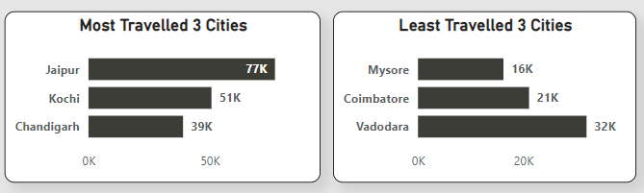
Identify the top 3 and bottom 3 cities by total trips over the entire analysis period.

Slide 8
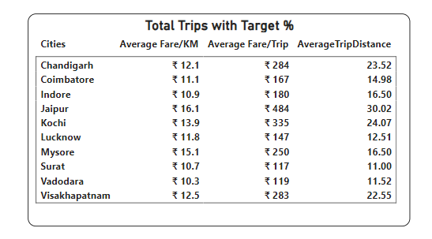
Calculate the average fare per trip for each city and compare it with the city's average trip distance. Identify the cities with the highest and lowest average fare per trip to assess pricing efficiency across locations.

Slide 9
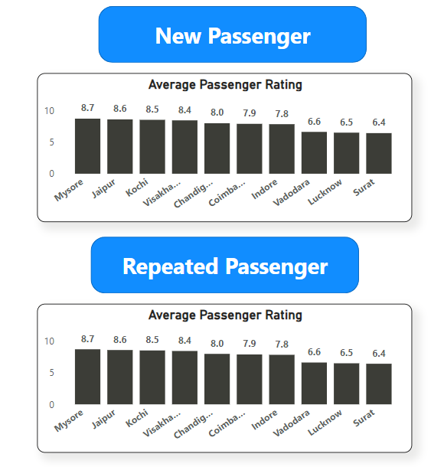
Calculate the average passenger and driver ratings for each city, segmented by passenger type (new vs. repeat). Identify cities with the highest and lowest average ratings.

Slide 10
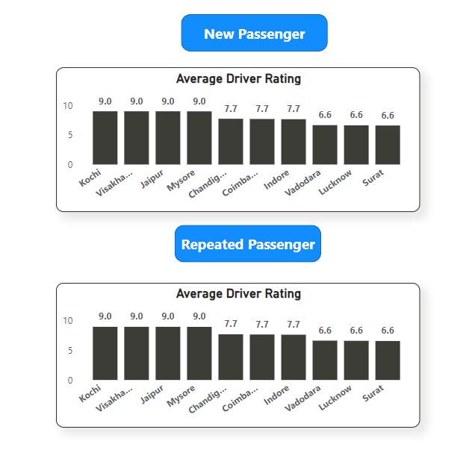
Calculate the average passenger and driver ratings for each city, segmented by passenger type (new vs. repeat). Identify cities with the highest and lowest average ratings.

Slide 11
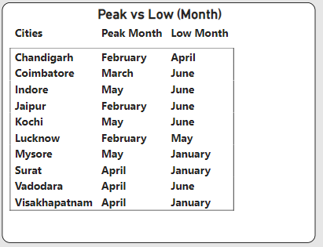
For each city, identify the month with the highest total trips (peak demand) and the month with the lowest total trips (low demand). This analysis will help Goodcabs understand seasonal patterns and adjust resources accordingly.

Slide 12
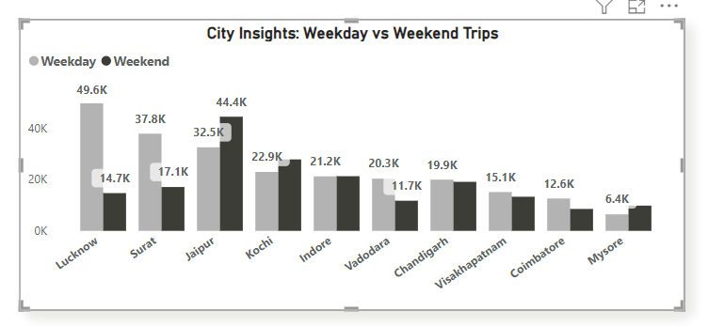
Compare the total trips taken on weekdays versus weekends for each city over the six-month period. Identify cities with a strong preference for either weekend or weekday trips to understand demand variations.

Slide 13
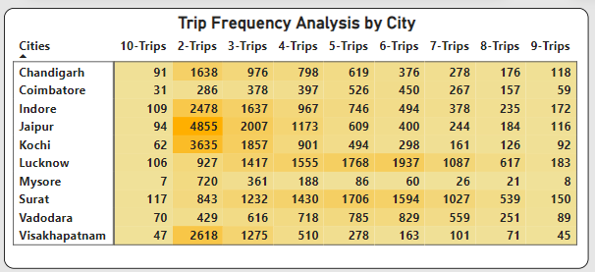
Analyse the frequency of trips taken by repeat passengers in each city (e.g., % of repeat passengers taking 2 trips, 3 trips, etc.). Identify which cities contribute most to higher trip frequencies among repeat passengers, and examine if there are distinguishable patterns between tourism-focused and business-focused cities.

Slide 14
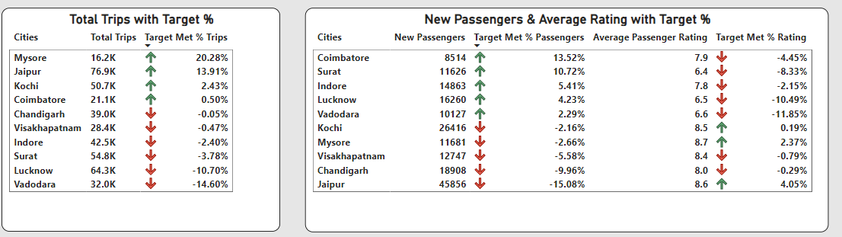
For each city, evaluate monthly performance against targets for total trips, new passengers, and average passenger ratings from targets_db. Determine if each metric met, exceeded, or missed the target, and calculate the percentage difference. Identify any consistent patterns in target achievement, particularly across tourism versus business-focused cities.

Slide 15
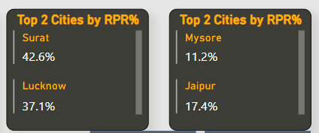
Identify the top 2 and bottom 2 cities based on their RPR% to determine which locations have the strongest and weakest rates.

Slide 16
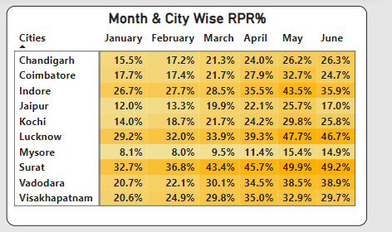
Similarly, analyse the RPR% by month across all cities and identify the months with the highest and lowest repeat passenger rates. This will help to pinpoint any seasonal patterns or months with higher repeat passenger loyalty.

Slide 17
GoodCabs: Performance insights and trends
SECONDARY ANALYSIS & RECOMMENDATIONS

Slide 18
Factors Influencing Repeat Passenger Rates
Recommendation
Affordability and convenience directly influence repeat passenger rates. Premium passengers prioritize convenience over affordability, emphasizing the need to deliver high-quality service. On the other hand, price-sensitive customers value competitive pricing, making affordability a key factor in retaining them.
Providing both affordability and convenience tailored to each passenger type, along with excellent service, can enhance customer retention. Offering reward points and discounts further fosters customer loyalty and long-term engagement.

Slide 19
Tourism vs. Business Demand Impact
Collaborating with hotels to provide services for their guests, such as pickup and drop-off to the airport or railway station. Similarly, Partnering with an IT firms to provide services for their business trips or other commuting needs through a contract will help expand the business.

Slide 20
Emerging Mobility Trends and Goodcabs' Adaptation
Transitioning to EV vehicles will lower expenses, positively impacting the firm’s profitability. Additionally, it supports environmental sustainability. Reduced operational costs will enable the company to offer services at more competitive prices.

Slide 21
Partnership Opportunities with Local Businesses
Collaborating with local travel agencies to include cabs for pickups, drop-offs, and complete travel as part of their packages can enhance service offerings. Similarly, partnering with local hotels, malls, and events to provide bundled packages, along with exclusive discounts, can boost business and increase brand visibility and popularity.

Slide 22
Data Collection for Enhanced Data-Driven Decisions
We need to collect data on on-time pickups and drop-offs to understand how many rides are completed as scheduled and how many deviate from the timeline.
Additionally, we should track data on ride acceptance and cancellations, including the time taken by drivers to accept rides and the reasons for cancellations, as well as similar data from the passenger's perspective.
We also need to gather information about payment modes. This will help in implementing a dedicated wallet system for the firm in the future, enabling us to offer exclusive discounts to passengers who use the wallet for payments.

Slide 23
GoodCabs: Performance insights and trends
AD-HOC BUSINESS REQUEST

Slide 24
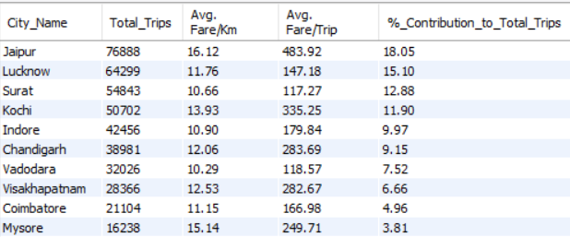
Generate a report that displays the total trips, average fare per km, average fare per trip, and the percentage contribution of each city’s trips to the overall trips. This report will help in assessing trip volume, pricing efficiency, and each city’s contribution to the overall trip count.

Slide 25
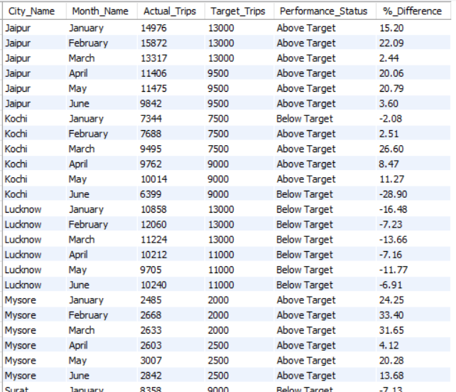
Generate a report that evaluates the target performance for trips at the monthly and city level. For each city and month, compare the actual total trips with the target trips and categorize the performance as follows:
If actual trips are greater than target trips, mark it as "Above Target".
If actual trips are less than or equal to target trips, mark it as "Below Target"
Additionally, calculate the % difference between actual and target trips to quantify the performance gap.

Slide 26
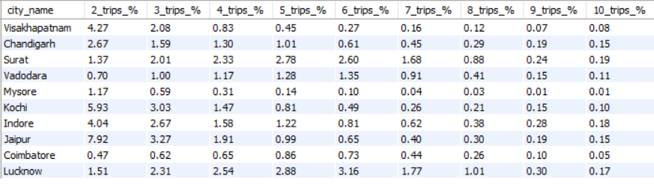
Generate a report that shows the percentage distribution of repeat passengers by the number of trips they have taken in each city. Calculate the percentage of repeat passengers who took 2 trips, 3 trips, and so on, up to 10 trips. Each column should represent a trip count category, displaying the percentage of repeat passengers who fall into that category out of the total repeat passengers for that city.

Slide 27
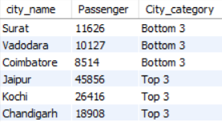
Generate a report that calculates the total new passengers for each city and ranks them based on this value. Identify the top 3 cities with the highest number of new passengers as well as the bottom 3 cities with the lowest number of new passengers, categorizing them as "Top 3" or "Bottom 3" accordingly.

Slide 28
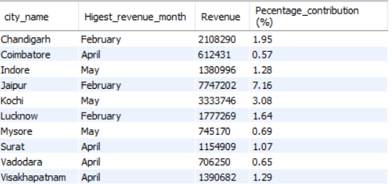
Generate a report that identifies the month with the highest revenue for each city. For each city, display the month_name, the revenue amount for that month, and the percentage contribution of that month’s revenue to the city’s total revenue.

Slide 29
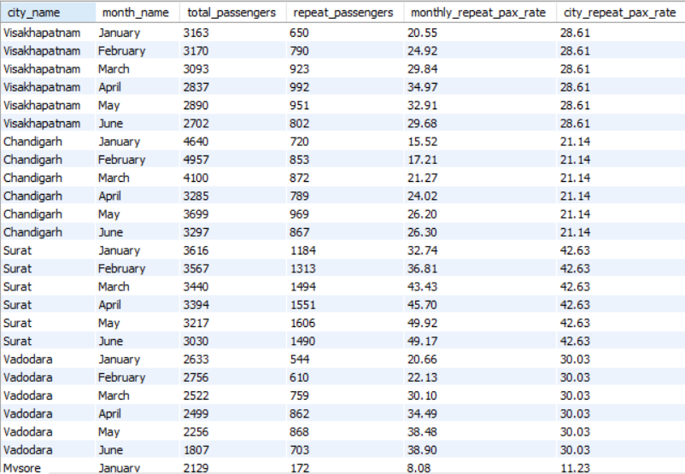
Generate a report that calculates two metrics:
Monthly Repeat Passenger Rate: Calculate the repeat passenger rate for each city and month by comparing the number of repeat passengers to the total passengers.
City-wide Repeat Passenger Rate: Calculate the overall repeat passenger rate for each city, considering all passengers across months.

Slide 30
THANK YOU
Linkedin
Portfolio
Github

